Slide 1
MECHANICAL TEAM WEEK 7
KENNEDY OUMA

Slide 2
TASKS COMPLETED THIS WEEK
Hydraulic pump motor coupling design completion
Steering torque calculation
Braking and clutching force measurement
Steering design completion

Slide 3
STEERING SYSTEM DESIGN
The design of the new steering system is complete. The materials and process of fabrication has already been identified and discussed.
The system will have the various components:
Rack and pinion system
3 universal joints
Connecting shafts (3m, 25mm dia)

Slide 4
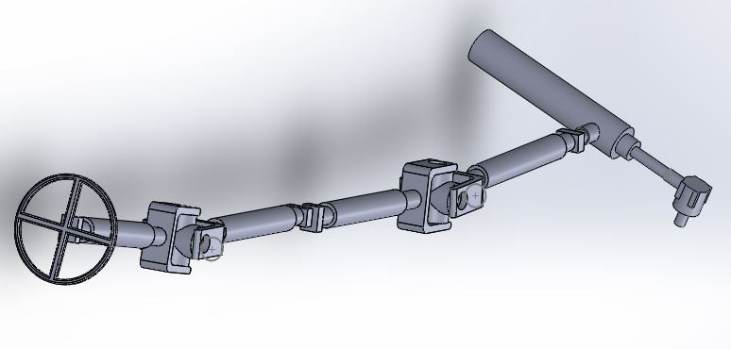
STEERING WHEEL CAD DESIGN

Slide 5
ACTUATORS
Selection of actuators has been done in consultation with the navigation team.
The force required to actuate the clutch and brake pedal was done using an electronic spring gauge.
The maximum force values obtained were 120N for the clutch pedal and 160N for the brake pedal.
The speed of actuation required for the clutch was found to be 5mm/s and the brake pedal 6.5mm/s.

Slide 6
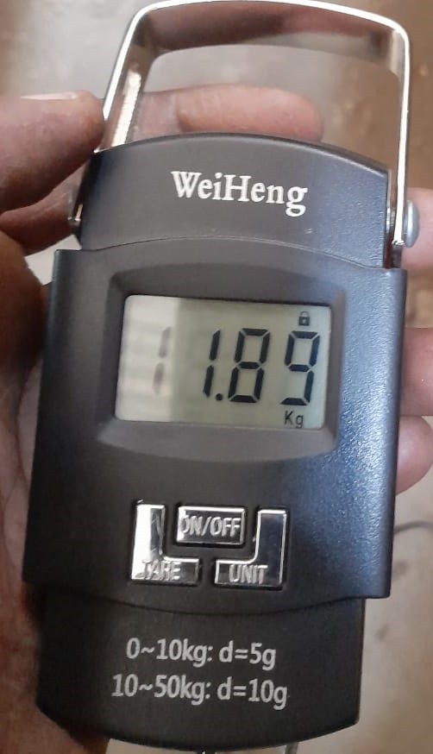
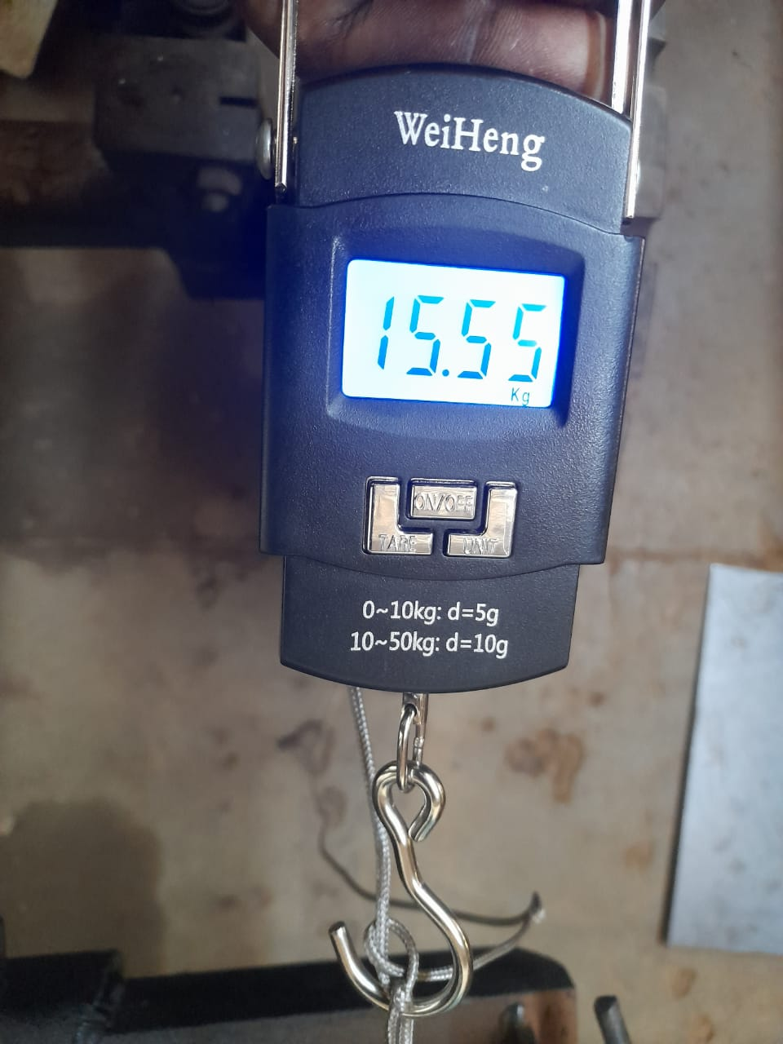
MEASUREMENT OF PEDAL FORCE
CLUTCH
BRAKE

Slide 7
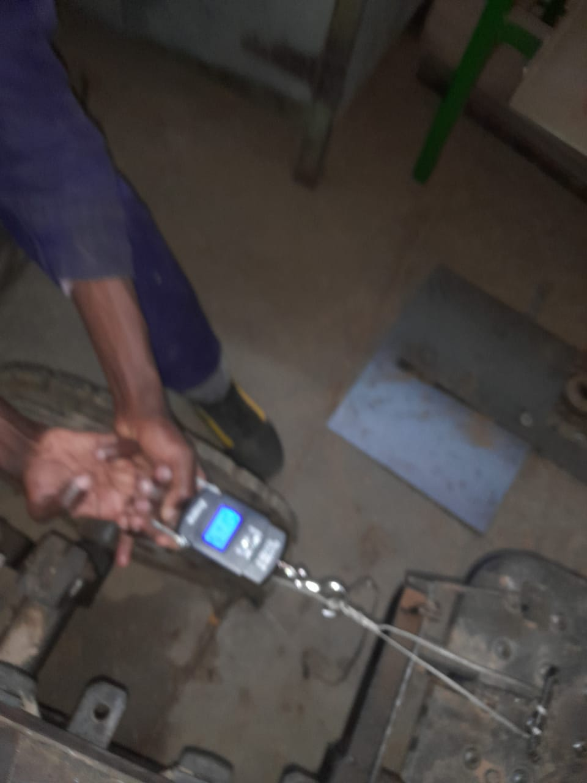
MEASURING PROCESS

Slide 8
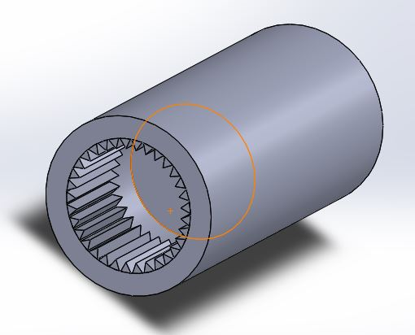
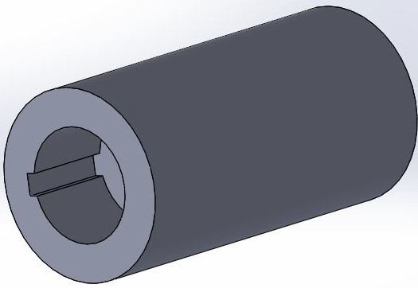
MOTOR AND PUMP COUPLING
FRONT (SPLINED)
BACK (KEYED)

Slide 9
MOTOR AND PUMP COUPLING CONT…
Pump coupling to be fabricated in NMS Railways because machine in engineering workshop cannot cut female splines
Heat treatment of component can be done in house.
Flywheel coupling fabrication is possible in school.
Material will have to be mild steel.
Heat treatment is necessary and be done in foundry shop but machine control unit is damaged

Slide 10
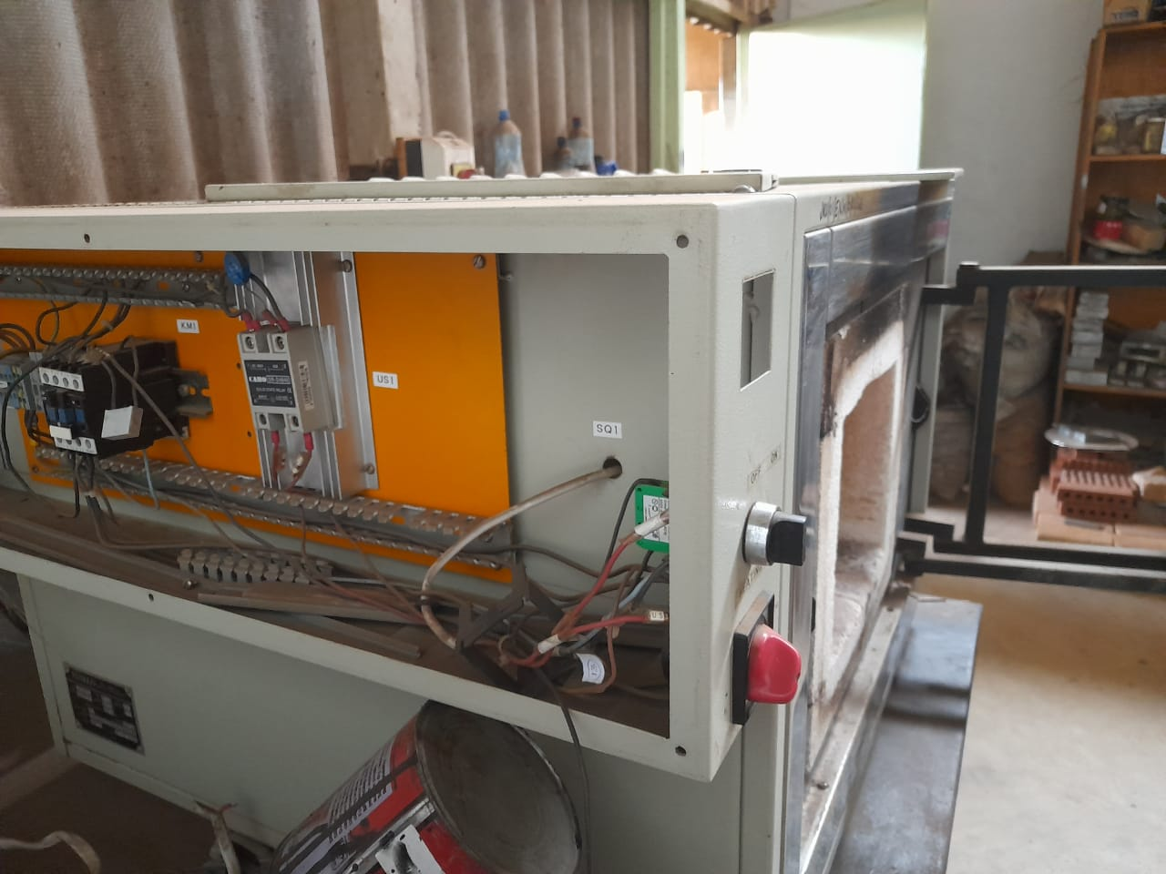
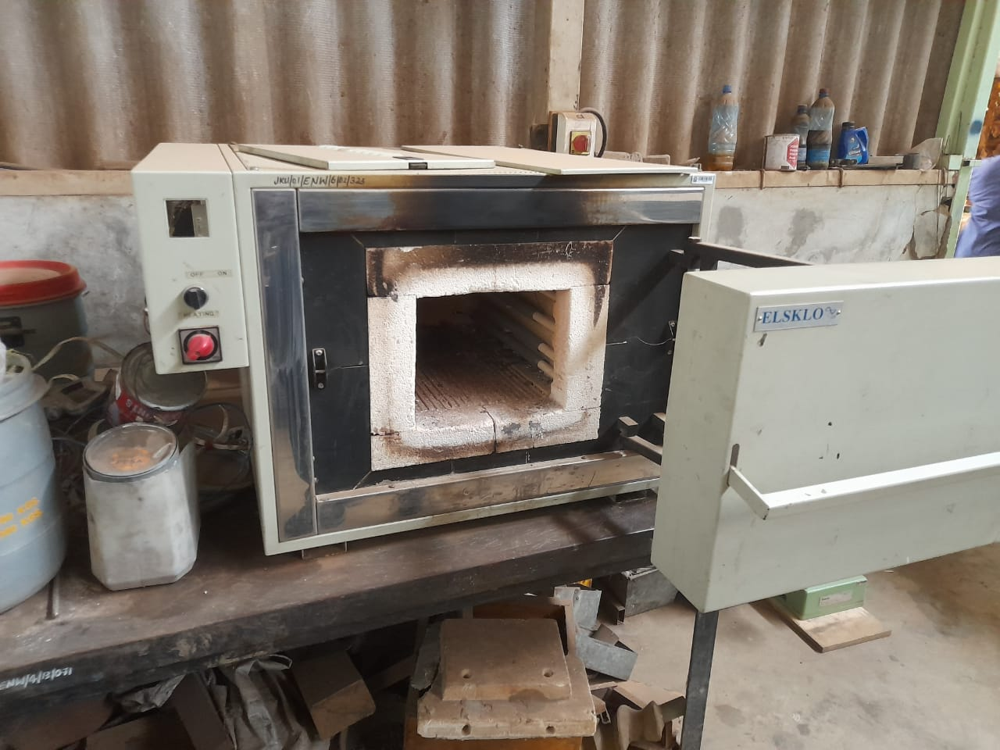
MACHINE CONTROL UNIT

Slide 11
HEAT TREATMENT
WHY HEAT TREATMENT?
Carbonization
Furnace
Machine in foundry workshop
Casenite compound - A chemical compound used for heat treatment
To allow to use mild steel because of difficulty in machining stainless steel

Slide 12
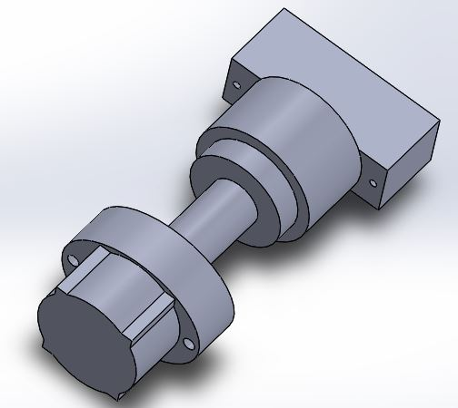
MOTOR AND PUMP ASSEMBLY
We have also completed the hydraulic pump and motor coupling.its designed with splines on one end and a key way on the other

Slide 13

STEERING CALCULATION
The calculations for steering wheel toque as follows,
W=Front axle weight=160kg
U=Coefficient of friction=0.7
E=kingpin offset=135mm
B=Width of tire=100mm
T= kingpin torque = 156.3 N-M

Slide 14
Steering calc cont…
Steering wheel torque=kingpin torque/steering ratio.
Standard steering ratio is 14:1 thus the steering wheel torque was found to be 11.2N-M.

Slide 15
THANK YOU
😀

